Slide 1

KARTHIK NAIR
December 3rd, 2024
FILIP TOMOVSKI
DS5110
CUSTOMER
BEHAVIOR DASHBOARD

Slide 2
PROJECT OVERVIEW
Objective: Develop a dashboard to support data-driven decision-making.
Customer behavior
Sales trends
Demographics
Scope:
Data collection and processing (sales, customer demographics, holiday trends)
Pipeline & database design (robust ETL pipeline, scalable database scheme)
Dashboard development (intuitive and interactive dashboard with user friendly design)
Trend visualizations (seasonal patterns, customer preferences, geographical distribution)
Key Features:
Sales analysis (find high-performing products and regions)
Holiday insights (highlight holiday sales spikes)
Geographical mapping (pinpoint customer density and geographical trends)
Performance metrics (total revenue, averages)

Slide 3
MOTIVATION AND IMPORTANCE
Why?
Businesses rely on data-driven decisions
Currently solutions lack interactivity
Incorporating external factors enhances sales trends
How?
Develop smarter marketing strategies
Enhance inventory management
Understand your customer base
Pinpoint peak sales periods
Added Value:
Improved operational efficiency
Data readable by all
Scalability

Slide 4
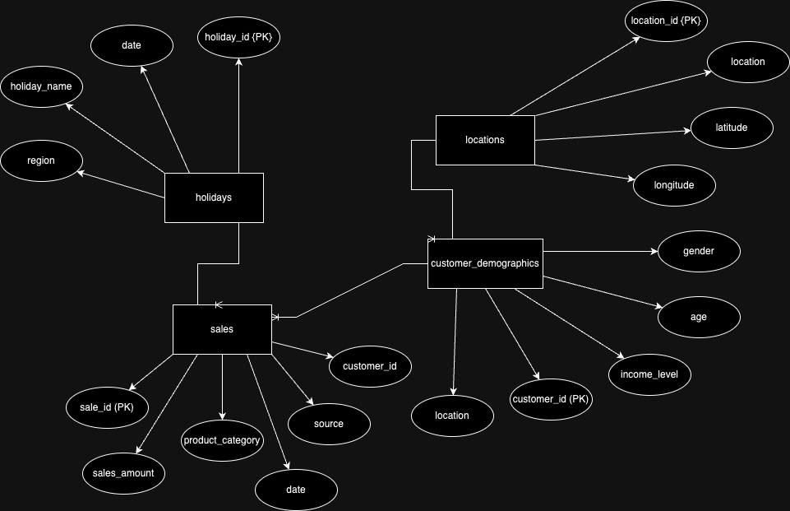
DATA SOURCES
Sales
Combined data for instore purchases from Walmart datasets and online purchases from Amazon data on Kaggle.
Locations
Studied how Walmart organizes stores across 2,614 cities and created a dataset for 2,000 cities based on proximity and population.
Holidays
Designed a dataset combining national holidays, regional holidays, and major retail events like Black Friday (2018–2023).
Customer Demographics
Synthesized data for 50,000 customers, including gender-neutral options, mapped to the 2,000 cities dataset.

Slide 5
LITERATURE REVIEW
Sales Data:
Retail Sales Trends: Studies on omnichannel retail strategies (Chen et al., 2020) emphasize the importance of integrating online and instore sales data to analyze customer behavior effectively. Using Walmart's instore data and Amazon's online sales data aligns with this approach, providing insights into shopping preferences and channel-specific trends.
Mode of Purchase: Research by Grewal et al. (2017) highlights how purchase modes (instore vs. online) impact customer satisfaction and sales patterns. Sampling these modes helps create a realistic dataset for understanding consumer behavior.
Locations Data:
Store Location Optimization: Literature on retail store placements (Reyes et al., 2019) suggests that factors like population density, proximity, and accessibility are critical in determining store locations. By studying Walmart's real-world store distribution across 2,614 cities, the dataset leverages proven methodologies for proximity-based location planning.
City-Level Analysis: Papers like "Geographic Retail Dynamics" (Thomas et al., 2018) validate the importance of selecting major cities for dataset creation, reflecting realistic retail coverage.
Holidays Data:
Seasonal Sales Patterns: Academic studies (e.g., Dekimpe et al., 2020) confirm that holidays like Black Friday and Christmas significantly influence retail sales spikes. Including regional holidays and retail-specific events in the dataset aligns with these findings, enabling accurate analysis of seasonal trends.
Regional Variations: Research on regional shopping behaviors (Hui et al., 2019) highlights the importance of incorporating state-specific holidays, like Patriots' Day, to capture localized sales patterns.
Customer Demographics:
Synthetic Data Generation: Studies on privacy-preserving synthetic data generation (Xu et al., 2019) validate the approach of synthesizing customer profiles, especially when real data is unavailable or incomplete.
Gender Inclusivity: Research on diversity in data (Smith et al., 2021) emphasizes the inclusion of gender-neutral options to ensure equitable representation, making the dataset more inclusive and aligned with modern standards.
Demographic Distribution: U.S. Census-based demographic studies (e.g., Frey, 2020) provide benchmarks for realistic age and income level distributions, ensuring the dataset reflects actual population characteristics.

Slide 6
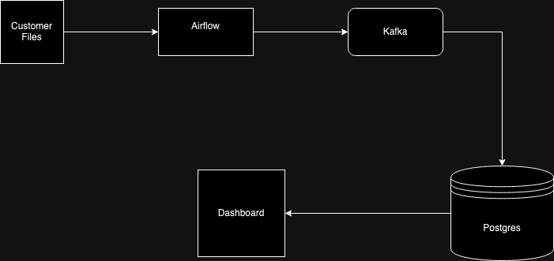
SYSTEM ARCHITECTURE

Slide 7
BACKEND DEMO

Slide 8
DASHBOARD DEMO

Slide 9
CONCLUSION
Outcomes:
Developed a scalable pipeline
Interactive dashboard with filter capabilities
Visualizations to support business decisions
Geospatial mapping
Limitations/Future work:
Scale to cloud-based storage
Enable real-time API
Multi-channel sales data (online or in-store)

Slide 10

THANK YOU

